Slide 1

Asymmetric-Key
Cryptography
Copyright © The McGraw-Hill Companies, Inc. Permission required for reproduction or display.
10.<number>

Slide 2
Chapter 10
Objectives
To distinguish between two cryptosystems:
symmetric-key and asymmetric-key
To introduce trapdoor one-way functions and their
use in asymmetric-key cryptosystems
To discuss the RSA cryptosystem
To discuss the Rabin cryptosystem
10.<number>

Slide 3
10-1 INTRODUCTION
Symmetric and asymmetric-key cryptography will exist in parallel and continue to serve the community. We actually believe that they are complements of each other; the advantages of one can compensate for the disadvantages of the other.
Topics discussed in this section:
10.1.1 Keys
10.1.2 General Idea
10.1.3 Need for Both
10.1.4 Trapdoor One-Way Function
10.1.5 Knapsack Cryptosystem
10.<number>

Slide 4

10-1 INTRODUCTION
Symmetric and asymmetric-key cryptography will exist in parallel and continue to serve the community. We actually believe that they are complements of each other; the advantages of one can compensate for the disadvantages of the other.
Note
Symmetric-key cryptography is based on sharing secrecy;
asymmetric-key cryptography is based on personal secrecy.
10.<number>

Slide 5
Private-Key Cryptography
traditional private/secret/single key cryptography uses one key
shared by both sender and receiver
if this key is disclosed communications are compromised
also is symmetric, parties are equal
hence does not protect sender from receiver forging a message & claiming is sent by sender
Notes:
So far all the cryptosystems discussed have been private/secret/single key (symmetric) systems. All classical, and modern block and stream ciphers are of this form.

Slide 6
Public-Key Cryptography
probably most significant advance in the 3000 year history of cryptography
uses two keys – a public & a private key
asymmetric since parties are not equal
uses clever application of number theoretic concepts to function
complements rather than replaces private key crypto
Notes:
Will now discuss the radically different public key systems, in which two keys are used. Anyone knowing the public key can encrypt messages or verify signatures, but cannot decrypt messages or create signatures, counter-intuitive though this may seem. It works by the clever use of number theory problems that are easy one way but hard the other. Note that public key schemes are neither more secure than private key (security depends on the key size for both), nor do they replace private key schemes (they are too slow to do so), rather they complement them.

Slide 7
Public-Key Cryptography
public-key/two-key/asymmetric cryptography involves the use of two keys:
  a public-key, which may be known by anybody, and can be used to encrypt messages, and verify signatures
  a private-key, known only to the recipient, used to decrypt messages, and sign (create) signatures
is asymmetric because
  those who encrypt messages or verify signatures cannot decrypt messages or create signatures

Slide 8

Public-Key Cryptography
Notes:
Stallings Fig 9.1

Slide 9
Why Public-Key Cryptography?
developed to address two key issues:
  key distribution – how to have secure communications in general without having to trust a KDC with your key
  digital signatures – how to verify a message comes intact from the claimed sender
public invention due to Whitfield Diffie & Martin Hellman at Stanford Uni in 1976
  known earlier in classified community
Notes:
The idea of public key schemes, and the first practical scheme, which was for key distribution only, was published in 1977 by Diffie & Hellman. The concept had been previously described in a classified report in 1970 by James Ellis (UK CESG) - and subsequently declassified in 1987. See History of Non-secret Encryption (at CESG). Its interesting to note that they discovered RSA first, then Diffie-Hellman, opposite to the order of public discovery!

Slide 10
Public-Key Characteristics
Public-Key algorithms rely on two keys with the characteristics that it is:
  computationally infeasible to find decryption key knowing only algorithm & encryption key
  computationally easy to en/decrypt messages when the relevant (en/decrypt) key is known
  either of the two related keys can be used for encryption, with the other used for decryption (in some schemes)
Notes:
Public key schemes utilise problems that are easy (P type) one way but hard (NP type) the other way, eg exponentiation vs logs, multiplication vs factoring. Consider the following analogy using padlocked boxes: traditional schemes involve the sender putting a message in a box and locking it, sending that to the receiver, and somehow securely also sending them the key to unlock the box. The radical advance in public key schemes was to turn this around, the receiver sends an unlocked box to the sender, who puts the message in the box and locks it (easy - and having locked it cannot get at the message), and sends the locked box to the receiver who can unlock it (also easy), having the key. An attacker would have to pick the lock on the box (hard).

Slide 11

Public-Key Cryptosystems
Notes:
Stallings Fig 9.4
Here see various components of public-key schemes used for both secrecy and authentication. Note that separate key pairs are used for each of these – receiver owns and creates secrecy keys, sender owns and creates authentication keys.

Slide 12
Public-Key Applications
can classify uses into 3 categories:
  encryption/decryption (provide secrecy)
  digital signatures (provide authentication)
  key exchange (of session keys)
some algorithms are suitable for all uses, others are specific to one

Slide 13
Security of Public Key Schemes
like private key schemes brute force exhaustive search attack is always theoretically possible
but keys used are too large (>512bits)
security relies on a large enough difference in difficulty between easy (en/decrypt) and hard (cryptanalyse) problems
more generally the hard problem is known, its just made too hard to do in practise
requires the use of very large numbers
hence is slow compared to private key schemes
Notes:
Public key schemes are no more or less secure than private key schemes - in both cases the size of the key determines the security. Note also that you can't compare key sizes - a 64-bit private key scheme has very roughly similar security to a 512-bit RSA - both could be broken given sufficient resources. But with public key schemes at least there's usually a firmer theoretical basis for determining the security since its based on well-known and well studied number theory problems.

Slide 14
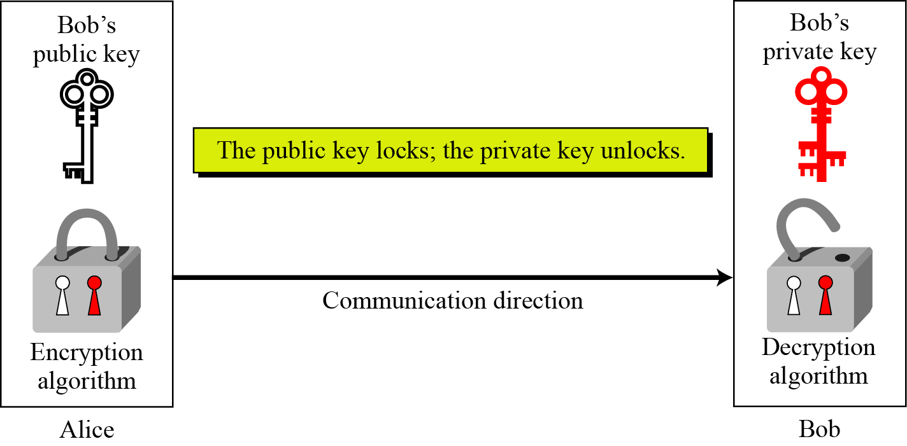
10.1.1 Keys
Asymmetric key cryptography uses two separate keys: one private and one public.
Figure 10.1 Locking and unlocking in asymmetric-key cryptosystem
10.<number>

Slide 15
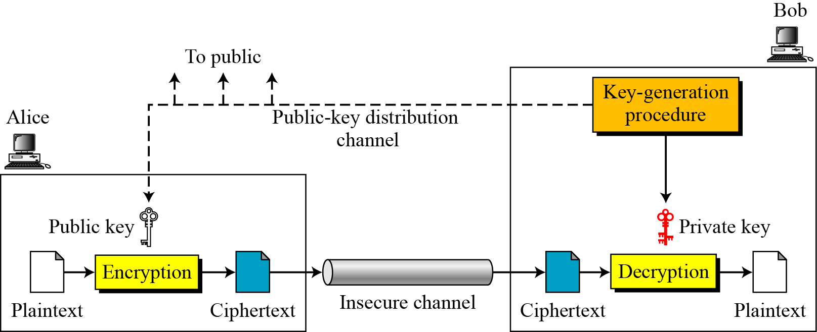
10.1.2 General Idea
Figure 10.2 General idea of asymmetric-key cryptosystem
10.<number>

Slide 16
10.1.2 Continued
Plaintext/Ciphertext
Unlike in symmetric-key cryptography, plaintext and ciphertext are treated as integers in asymmetric-key cryptography.
Encryption/Decryption
C = f (K_{public} , P) P = g(K_{private} , C)
10.<number>

Slide 17
10.1.3 Need for Both
There is a very important fact that is sometimes misunderstood: The advent of asymmetric-key cryptography does not eliminate the need for symmetric-key cryptography.
10.<number>

Slide 18
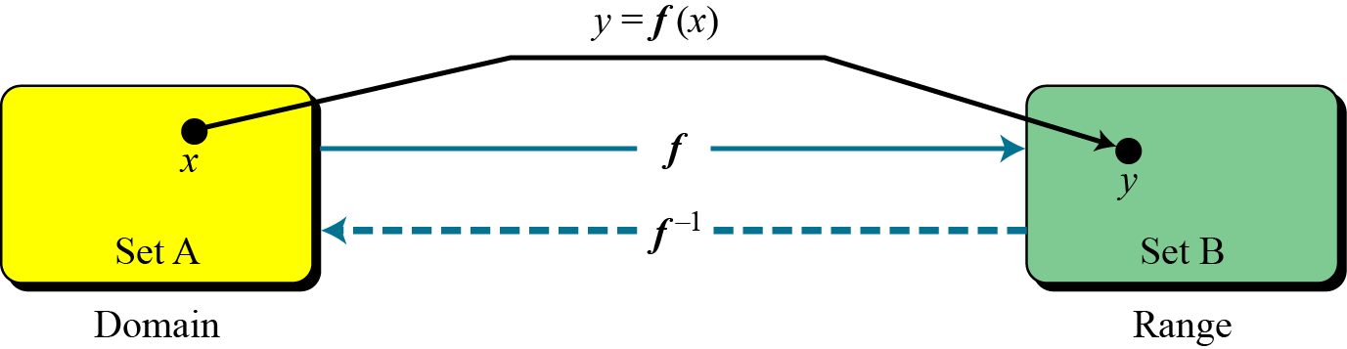
10.1.4 Trapdoor One-Way Function
The main idea behind asymmetric-key cryptography is the concept of the trapdoor one-way function.
Functions
Figure 10.3 A function as rule mapping a domain to a range
10.<number>

Slide 19
10.1.4 Continued
One-Way Function (OWF)
1. f is easy to compute.
2. f ⁻¹ is difficult to compute.
Trapdoor One-Way Function (TOWF)
3. Given y and a trapdoor, x can be
computed easily.
10.<number>

Slide 20
10.1.4 Continued
Example 10. 1
When n is large, n = p × q is a one-way function. Given p and q , it is always easy to calculate n ; given n, it is very difficult to compute p and q. This is the factorization problem.
Example 10. 2
When n is large, the function y = x^{k} mod n is a trapdoor one-way function. Given x, k, and n, it is easy to calculate y. Given y, k, and n, it is very difficult to calculate x. This is the discrete logarithm problem. However, if we know the trapdoor, k′ such that k × k ′ = 1 mod φ(n), we can use x = y^{k′} mod n to find x.
10.<number>

Slide 21
10-2 RSA CRYPTOSYSTEM
The most common public-key algorithm is the RSA cryptosystem, named for its inventors (Rivest, Shamir, and Adleman).
Topics discussed in this section:
10.2.1 Introduction
10.2.2 Procedure
10.2.3 Some Trivial Examples
10.2.4 Attacks on RSA
10.2.5 Recommendations
10.2.6 Optimal Asymmetric Encryption Padding (OAEP)
10.2.7 Applications
10.<number>

Slide 22
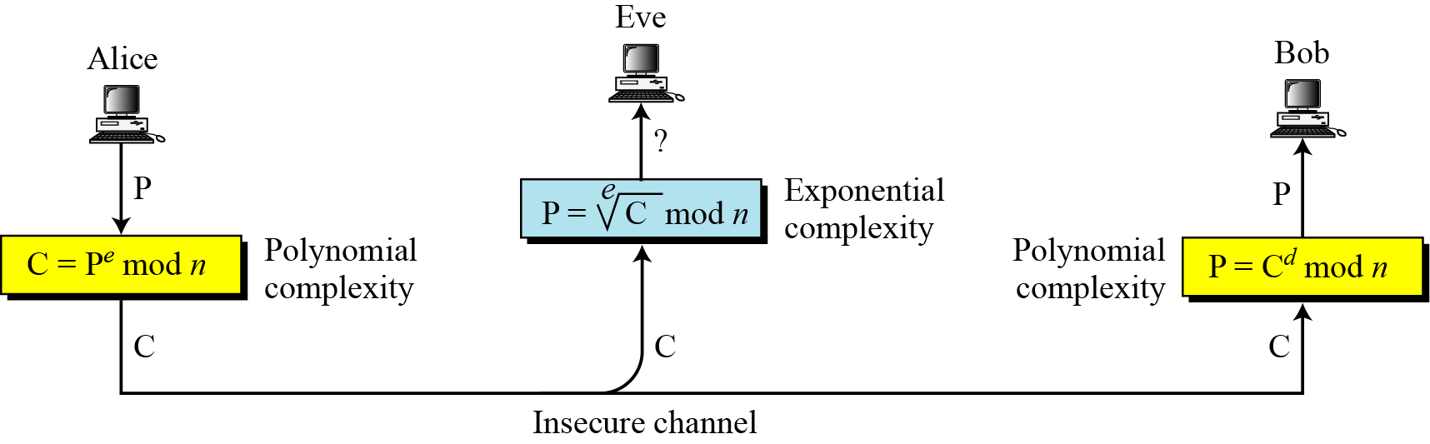
10.2.1 Introduction
Figure 10.5 Complexity of operations in RSA
10.<number>

Slide 23
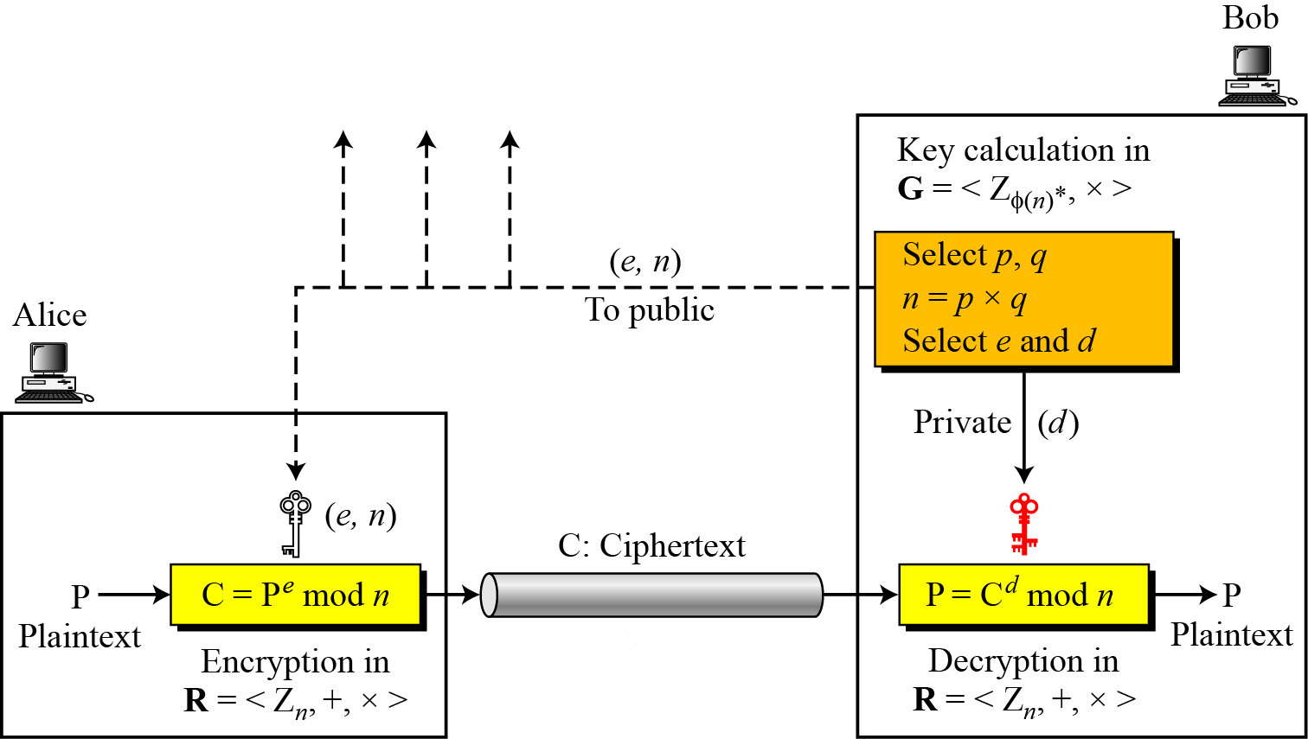
10.2.2 Procedure
Figure 10.6 Encryption, decryption, and key generation in RSA
10.<number>

Slide 24
10.2.2 Continued
Two Algebraic Structures
R = <Z_{n} , +, × >
Encryption/Decryption Ring:
Key-Generation Group:
G = <Z _{φ(n)}∗, × >
10.<number>

Slide 25
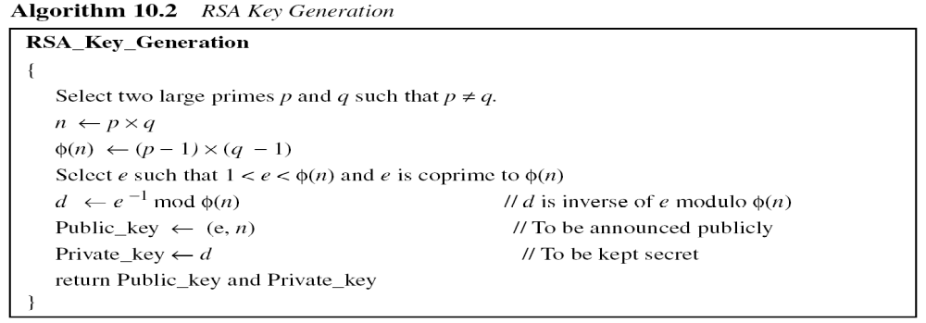
10.2.2 Continued
10.<number>

Slide 26
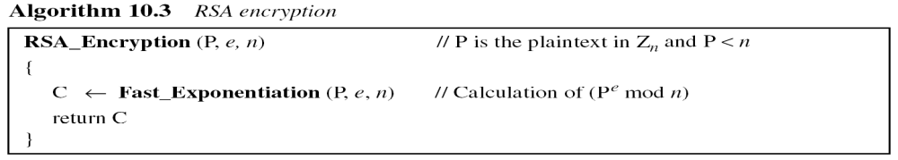
10.2.2 Continued
Encryption
10.<number>

Slide 27
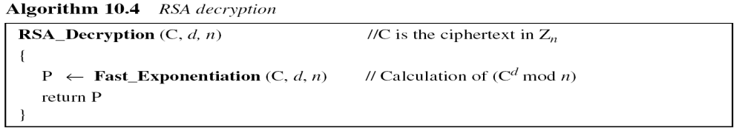
10.2.2 Continued
Decryption
10.<number>

Slide 28
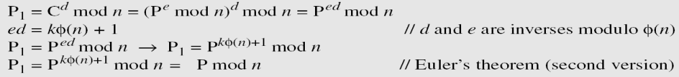
10.2.2 Continued
Proof of RSA
10.<number>

Slide 29
10.2.3 Some Trivial Examples
Example 10. 5
Bob chooses 7 and 11 as p and q and calculates n = 77. The value of φ(n) = (7 − 1)(11 − 1) or 60. Now he chooses two exponents, e and d, from Z₆₀∗. If he chooses e to be 13, then d is 37. Note that e × d mod 60 = 1 (they are inverses of each Now imagine that Alice wants to send the plaintext 5 to Bob. She uses the public exponent 13 to encrypt 5.
Bob receives the ciphertext 26 and uses the private key 37 to decipher the ciphertext:
10.<number>

Slide 30
10.2.3 Some Trivial Examples
Example 10. 6
Now assume that another person, John, wants to send a message to Bob. John can use the same public key announced by Bob (probably on his website), 13; John’s plaintext is 63. John calculates the following:
Bob receives the ciphertext 28 and uses his private key 37 to decipher the ciphertext:
10.<number>

Slide 31
10.2.3 Some Trivial Examples
Example 10. 7
Jennifer creates a pair of keys for herself. She chooses p = 397 and q = 401. She calculates
n = 159197. She then calculates φ(n) = 158400. She then chooses e = 343 and d = 12007. Show how Ted can send a message to Jennifer if he knows e and n.
Suppose Ted wants to send the message “NO” to Jennifer. He changes each character to a number (from 00 to 25), with each character coded as two digits. He then concatenates the two coded characters and gets a four-digit number. The plaintext is 1314. Figure 10.7 shows the process.
10.<number>

Slide 32
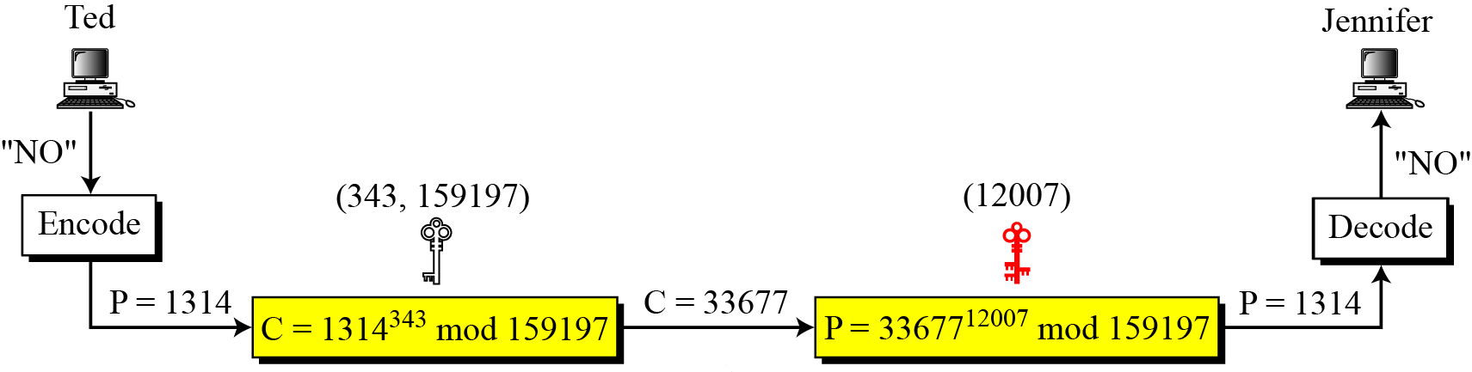
10.2.3 Continued
Figure 10.7 Encryption and decryption in Example 10.7
10.<number>

Slide 33
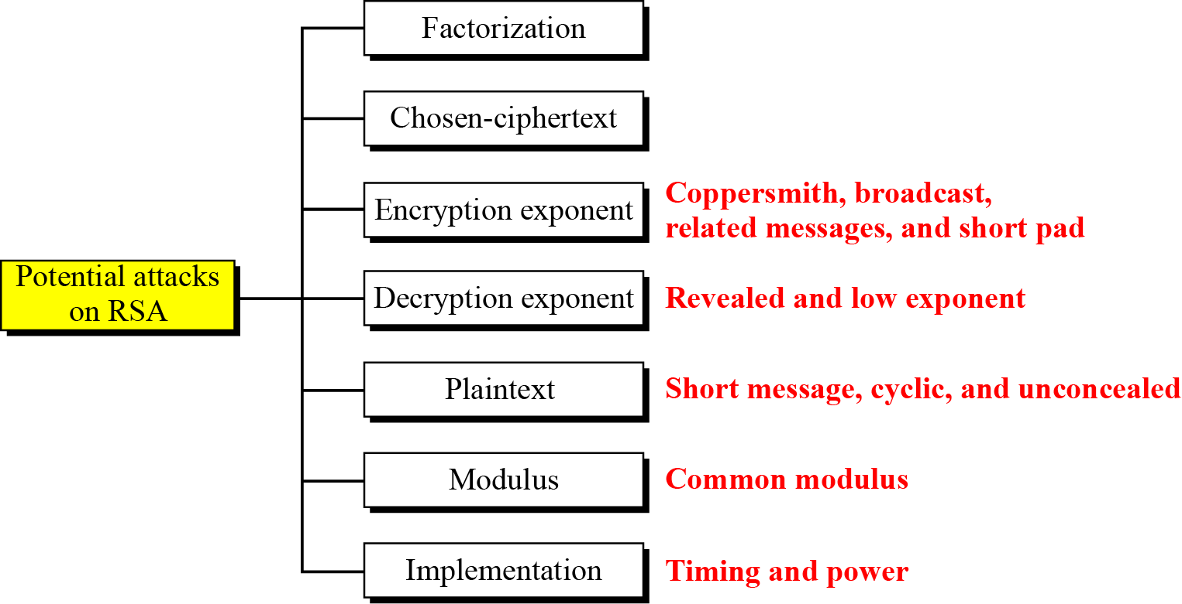
10.2.4 Attacks on RSA
Figure 10.8 Taxonomy of potential attacks on RSA
No devastating attacks on RSA have been yet discovered.
10.<number>

Slide 34
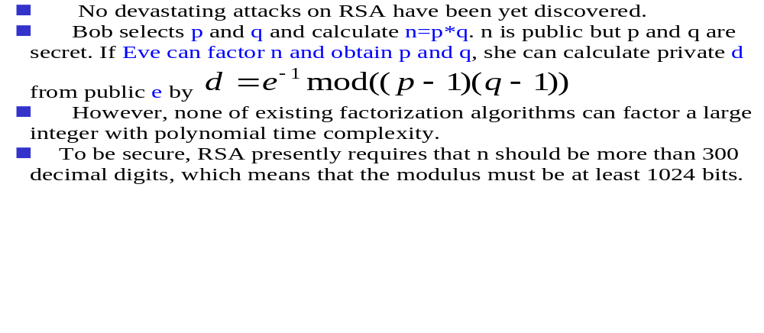
10.2.4 Attacks on RSA – Factorization Attack
10.<number>

Slide 35
10.2.4 Attacks on RSA – Chosen ciphertext attack
Chosen-ciphertext attack
  Assume Alice creates the ciphertext and sends C to Bob. Also assume that Bob will decrypt an arbitrary ciphertext for Eve, other than C.
  Eve intercepts C and uses the following steps:
    Eve chooses a random integer X
    Eve calculates Y = C * X^e mod n
    Eve sends Y to Bob for decryption and get Z=Y^d mod n; this step is an instance of a chosen ciphertext attack.
    Eve can easily find C because
    Z = Y^d mod n = (C * X^e)^d mod n = (C^d * X^ed) mod n = (C^d * X) mod n = (P*X)mod n
    Z = (P*X)mod n → P = Z*X^(-1) mod n
10.<number>

Slide 36
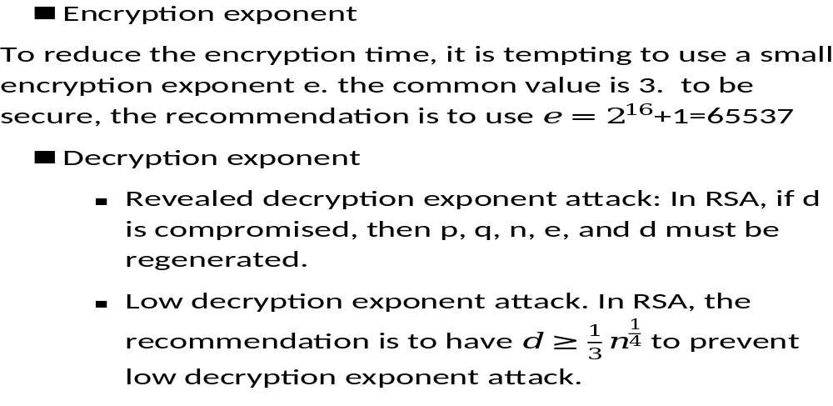
Attacks on RSA – attacks on encryption exponent
10.<number>

Slide 37
10.2.4 Attacks on RSA – Plaintext attack
Plaintext attack
  Short message attack – if it is known that Alice is sending a four-digit number to Bob, Eve can easily try plaintext numbers from 0000 to 9999 to find the plaintext. Therefore, short msg must be padded with random bits.
  Cycling attack – the continuous encryption of the ciphertext will eventually result in the plaintext. The complexity of this is equivalent to the complexity of factoring n.
  Concealed Message – a message that encrypts to itself, e.g. P=0 and P=1
10.<number>

Slide 38
10.2.4 Attacks on RSA -- Attacks on implementation
Timing attack
  RSA fast-exponential algorithm uses
    only squaring if the corresponding bit in the private exponent d is 0. requires shorter time to decrypt.
    Both squaring and multiplication if the corresponding bit is 1. requires longer time to decrypt
  This timing difference allows Eve to find the value of bits in d, one by one.
Powering attack
  An iteration involving multiplication and squaring consumes more power than an iteration that uses only squaring.
10.<number>

Slide 39
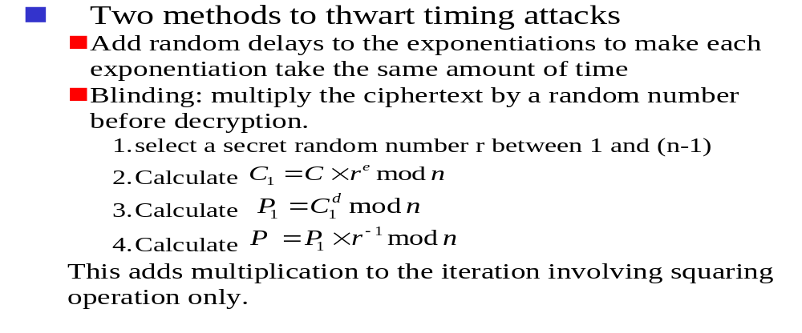
10.2.4 Attacks on RSA -- Attacks on implementation
10.<number>

Slide 40
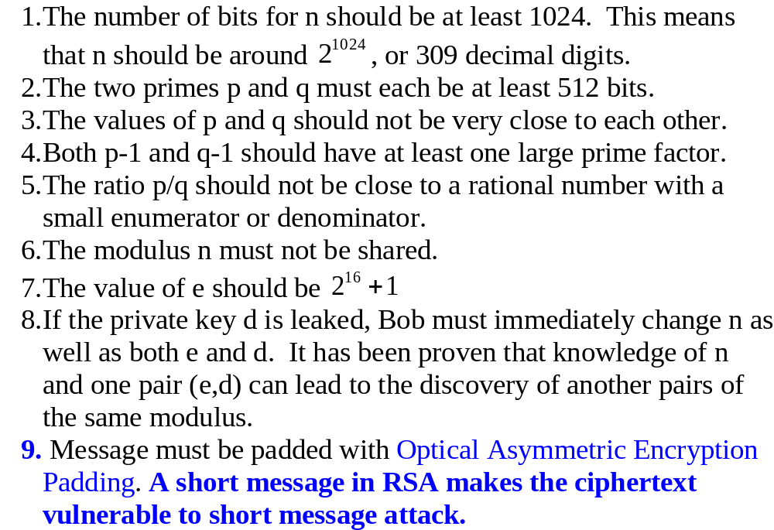
RSA Recommendations
10.<number>

Slide 41
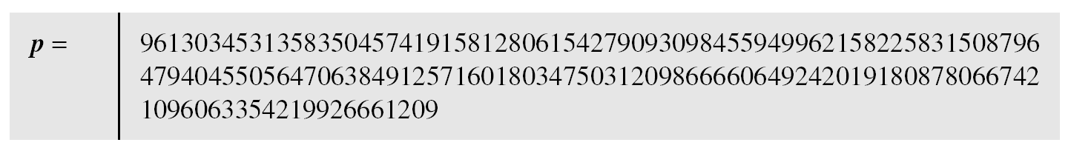
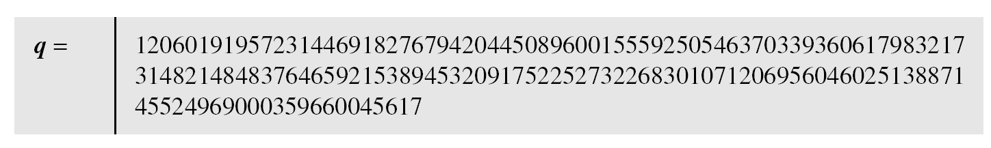
10.2.6 Continued
Example 10. 8
Here is a more realistic example. We choose a 512-bit p and q, calculate n and φ(n), then choose e and test for relative primeness with φ(n). We then calculate d. Finally, we show the results of encryption and decryption. The integer p is a 159-digit number.
10.<number>

Slide 42
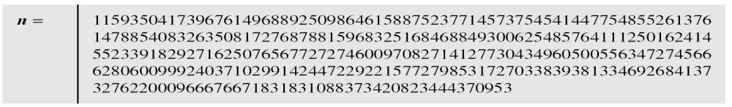
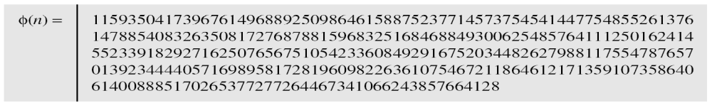
10.2.6 Continued
Example 10. 8
Continued
The modulus n = p × q. It has 309 digits.
φ(n) = (p − 1)(q − 1) has 309 digits.
10.<number>

Slide 43
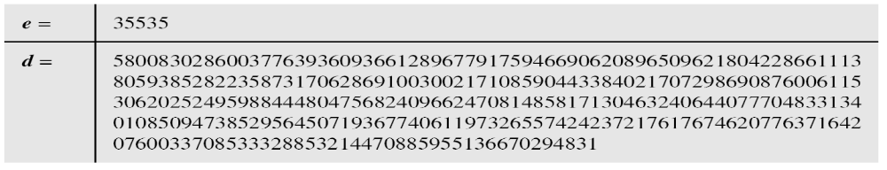
10.2.6 Continued
Example 10. 8
Continued
Bob chooses e = 35535 (the ideal is 65537) and tests it to make sure it is relatively prime with φ(n). He then finds the inverse of e modulo φ(n) and calls it d.
10.<number>

Slide 44
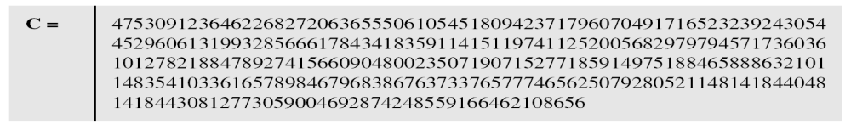
10.2.6 Continued
Example 10. 8
Continued
Alice wants to send the message “THIS IS A TEST”, which can be changed to a numeric value using the 00−26 encoding scheme (26 is the space character).
The ciphertext calculated by Alice is C = P^{e}, which is
10.<number>

Slide 45
10.2.6 Continued
Example 10. 8
Continued
Bob can recover the plaintext from the ciphertext using P = C^{d}, which is
The recovered plaintext is “THIS IS A TEST” after decoding.
10.<number>

Slide 46
10-3 RABIN CRYPTOSYSTEM
The Rabin cryptosystem can be thought of as an RSA cryptosystem in which the value of e and d are fixed. The encryption is C ≡ P² (mod n) and the decryption is P ≡ C^{1/2} (mod n).
Topics discussed in this section:
10.3.1 Procedure
10.3.2 Security of the Rabin System
10.<number>

Slide 47
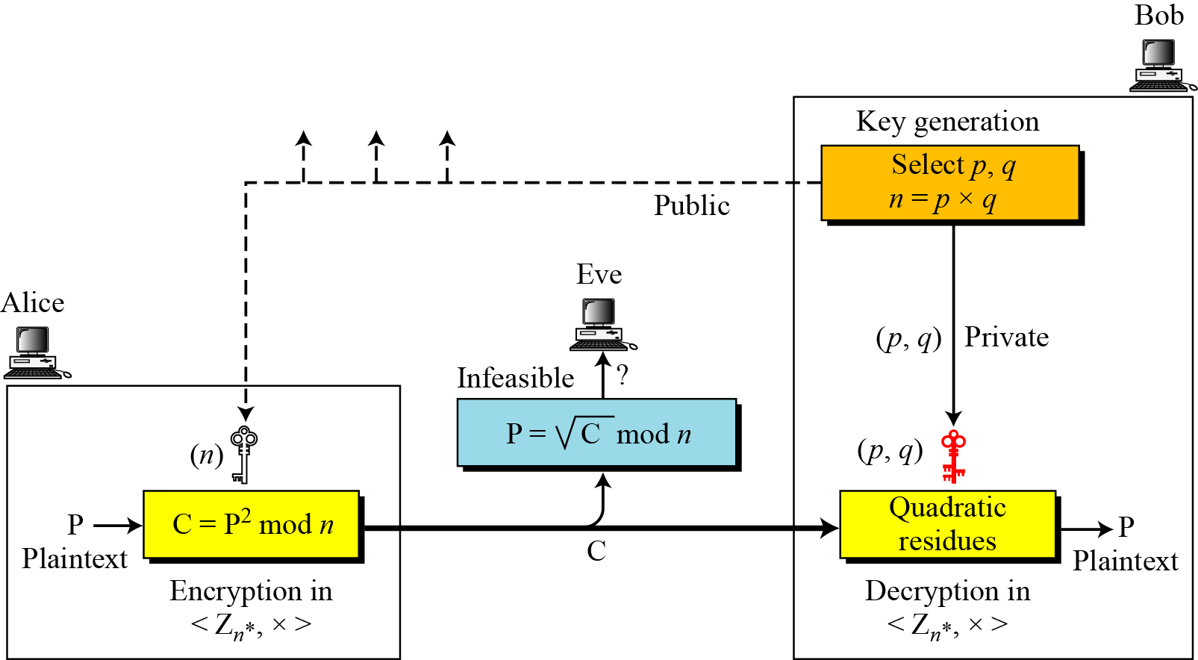
10-3 Continued
Figure 10.10 Rabin cryptosystem
10.<number>

Slide 48
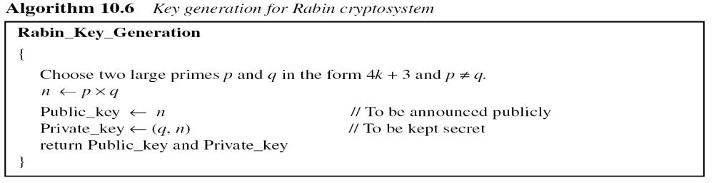
10.3.1 Procedure
Key Generation
10.<number>

Slide 49
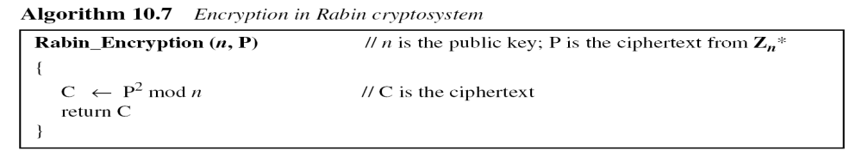
10.3.1 Continued
Encryption
10.<number>

Slide 50
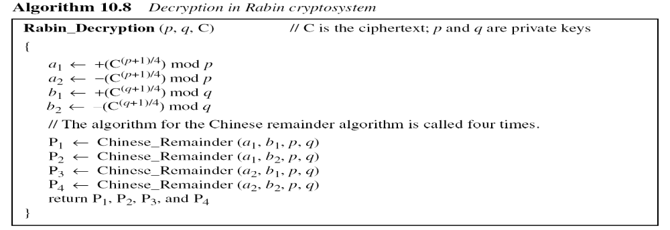
10.3.1 Continued
Decryption
Note
The Rabin cryptosystem is not deterministic: Decryption creates four plaintexts.
10.<number>

Slide 51
10.3.1 Continued
Example 10. 9
Here is a very trivial example to show the idea.
Bob selects p = 23 and q = 7. Note that both are
congruent to 3 mod 4.
Bob calculates n = p × q = 161.
Bob announces n publicly; he keeps p and q private.
Alice wants to send the plaintext P = 24. Note that 161 and 24 are relatively prime; 24 is in Z₁₆₁*. She calculates C = 24² = 93 mod 161, and sends the ciphertext 93 to Bob.
10.<number>

Slide 52
10.3.1 Continued
Example 10. 9
Bob receives 93 and calculates four values:
a₁ = +(93 ^{(23+1)/4}) mod 23 = 1 mod 23
a₂ = −(93 ^{(23+1)/4}) mod 23 = 22 mod 23
b₁ = +(93 ^{(7+1)/4}) mod 7 = 4 mod 7
b₂ = −(93 ^{(7+1)/4}) mod 7 = 3 mod 7
Bob takes four possible answers, (a₁, b₁), (a₁, b₂), (a₂, b₁), and (a₂, b₂), and uses the Chinese remainder theorem to find four possible plaintexts: 116, 24, 137, and 45. Note that only the second answer is Alice’s plaintext.
10.<number>

Slide 53
Security of Rabin System
  Secure as long as p and q are large numbers
  Complexity same as factoring a large number n into its prime factors p and q
  Rabin system is as secure as RSA
10.<number>

Slide 54
15-3 SYMMETRIC-KEY AGREEMENT
Alice and Bob can create a session key between themselves without using a KDC. This method of session-key creation is referred to as the symmetric-key agreement.
Topics discussed in this section:
15.3.1 Diffie-Hellman Key Agreement
15.<number>

Slide 55
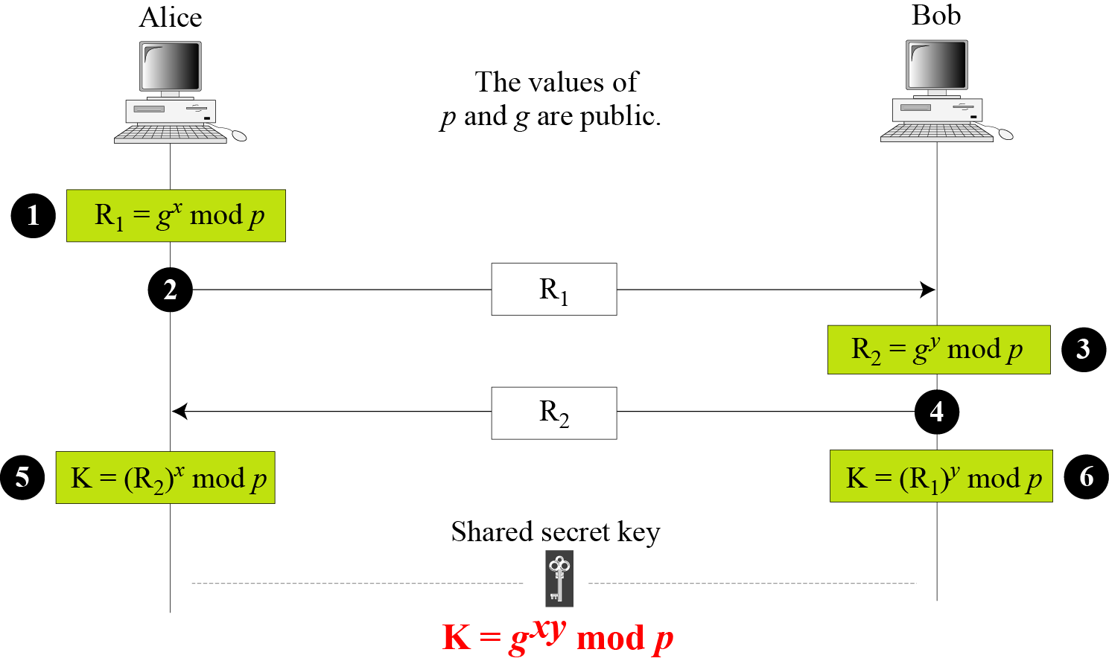
15.3.1 Diffie-Hellman Key Agreement
Figure 15.9 Diffie-Hellman method
15.<number>

Slide 56
15.3.1 Continued
Note
The symmetric (shared) key in the Diffie-Hellman method is K = g^{xy} mod p.
15.<number>

Slide 57
15.3.1 Continued
Example 15.1
Let us give a trivial example to make the procedure clear. Our example uses small numbers, but note that in a real situation, the numbers are very large. Assume that g = 7 and p = 23. The steps are as follows:
Alice chooses x = 3 and calculates R₁ = 73 mod 23 = 21.
Bob chooses y = 6 and calculates R₂ = 76 mod 23 = 4.
Alice sends the number 21 to Bob.
Bob sends the number 4 to Alice.
Alice calculates the symmetric key K = 43 mod 23 = 18.
Bob calculates the symmetric key K = 216 mod 23 = 18.
The value of K is the same for both Alice and Bob;
g^{xy} mod p = 718 mod 35 = 18.
15.<number>

Slide 58
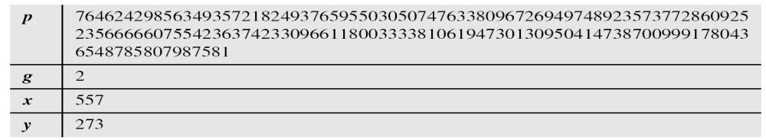
15.3.1 Continued
Example 15.2
Let us give a more realistic example. We used a program to create a random integer of 512 bits (the ideal is 1024 bits). The integer p is a 159-digit number. We also choose g, x, and y as shown below:
15.<number>

Slide 59
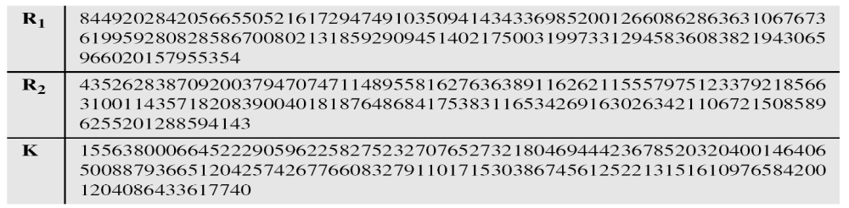
15.3.1 Continued
Example 15.2
Continued
The following shows the values of R₁, R₂, and K.
15.<number>

Slide 60
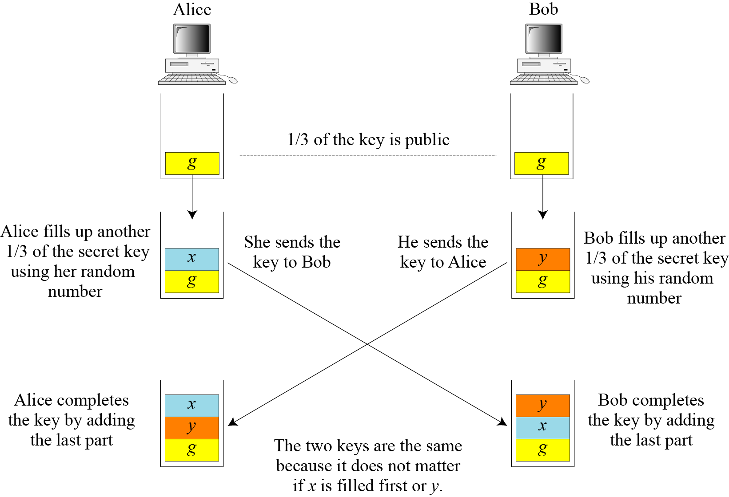
15.3.1 Continued
Figure 15.10 Diffie-Hellman idea
15.<number>

Slide 61
15.3.1 Continued
Security of Diffie-Hellman
Discrete Logarithm Attack
Man-in-the-Middle Attack
15.<number>

Slide 62
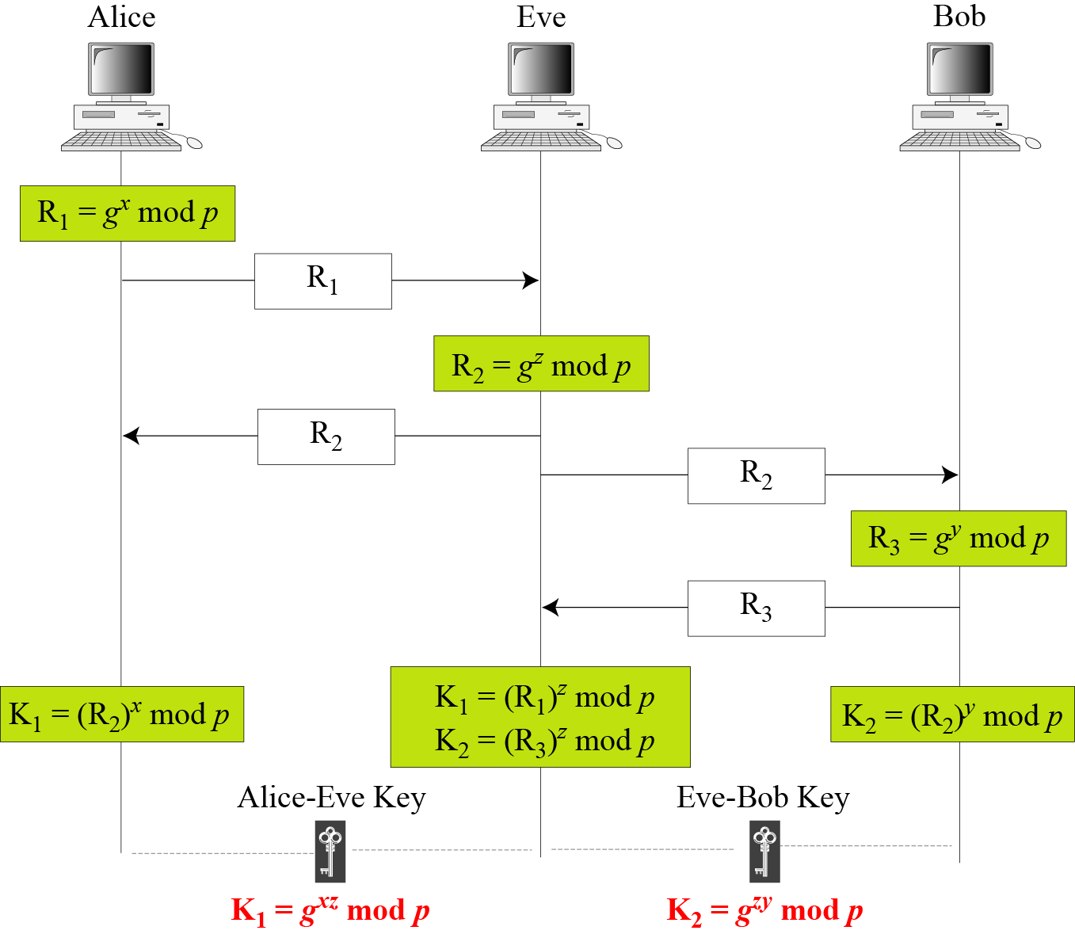
15.3.1 Continued
Figure 15.11 Man-in-the-middle attack
15.<number>

Slide 63
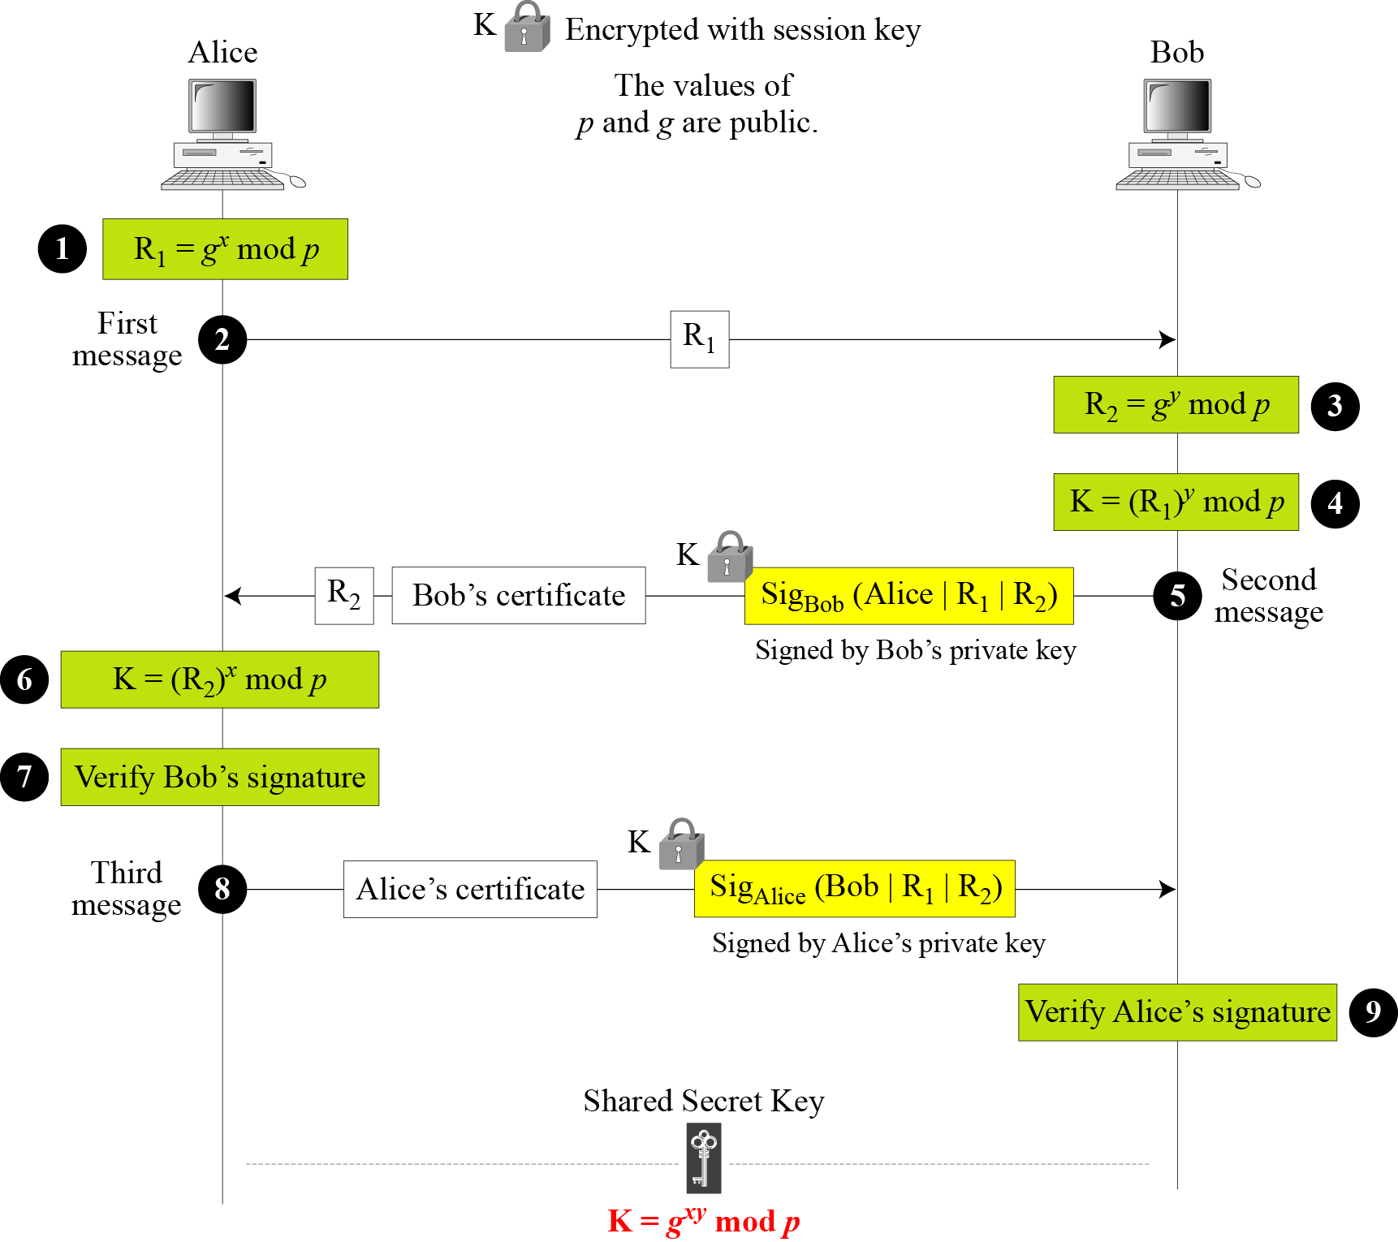
15.3.2 Station-to-Station Key Agreement
Figure 15.12 Station-to-station key agreement method
15.<number>

